Slide 1
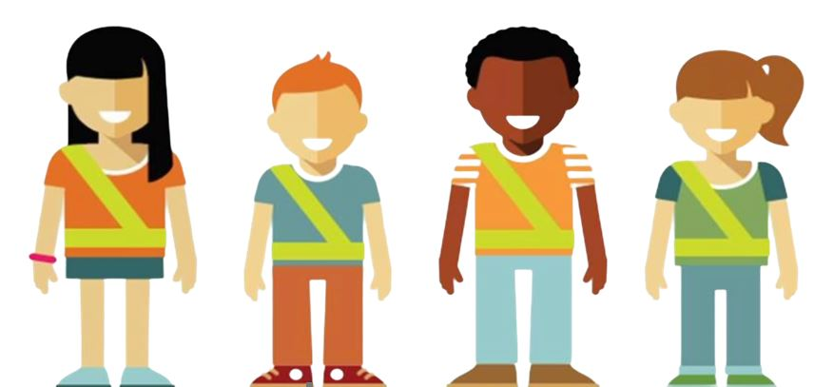
AAA School Safety Patrol Patroller Training

Slide 2
*Presenter Notes*
**Prior to presenting, locate this slide on the left menu,
right click on the slide and select “Hide Slide” **
This presentation is intended for SCHOOL SAFETY PATROL ADVISORS to provide training for students chosen as Patrollers for the AAA School Safety Patrol Program.
This presentation includes:
Uniform and equipment care
Goal of the program
Defining a safety hazard
Qualities of a great Patroller
Training Exercises
How to communicate with others
Officer roles
Posts
AAA School Safety Patrol Pledge

Slide 3
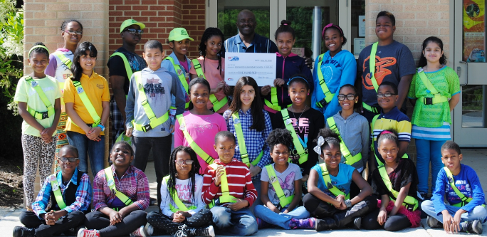
Welcome to the
AAA School Safety Patrol
You are now an important part of a group of 679,000 patrollers nationwide.

Slide 4
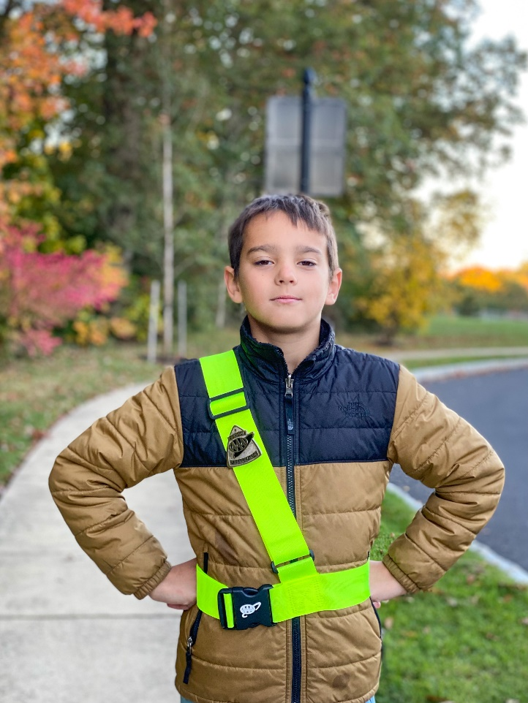
The Uniform
The Patroller uniform is composed of a belt and badge:
Belts should be worn over the right shoulder and buckled in the front.
Badge should be pinned on shoulder strap at chest level.
Only remove badge if belt is being cleaned (constant removing can break the pin).
Notes:
-It is recommended that belts/badges only be worn when the student is on post. It should be folded and stored in a designated area when not in use.
-Why are the belts so bright?
The “letric lime” color was chosen when the Federal Government changed the color of road signs related to pedestrians, bicycles, and school warning signs

Slide 5
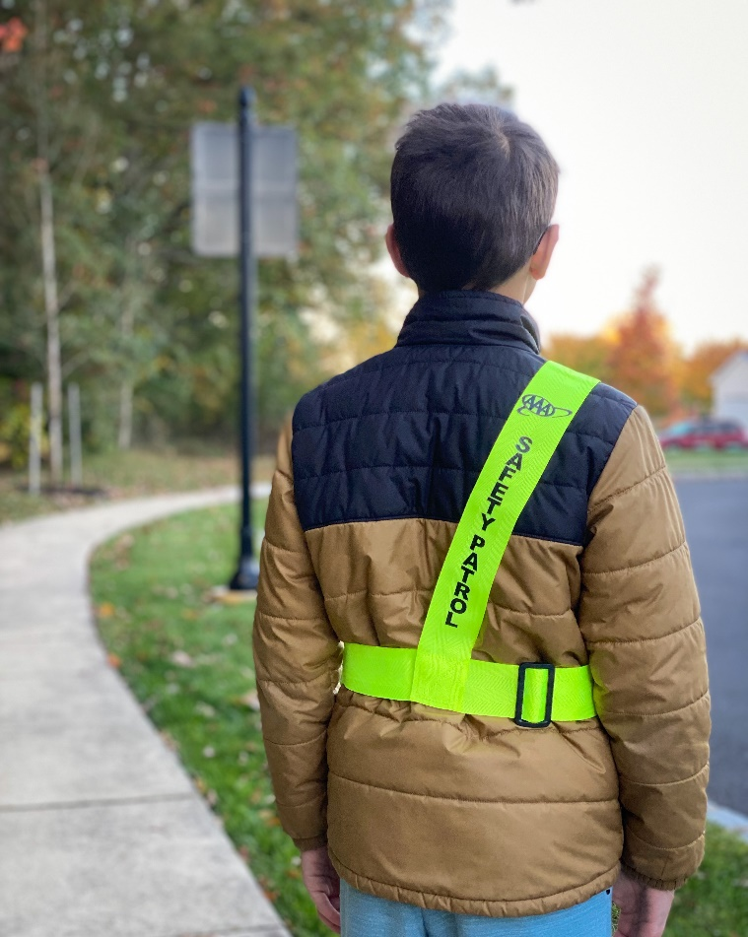
The Uniform
Why is the belt worn this way?
The words “Safety Patrol” should be positioned on your back so anyone behind you can identify you as part of the patrol.
The badge on the front shows anyone facing you that you are part of the patrol.

Slide 6
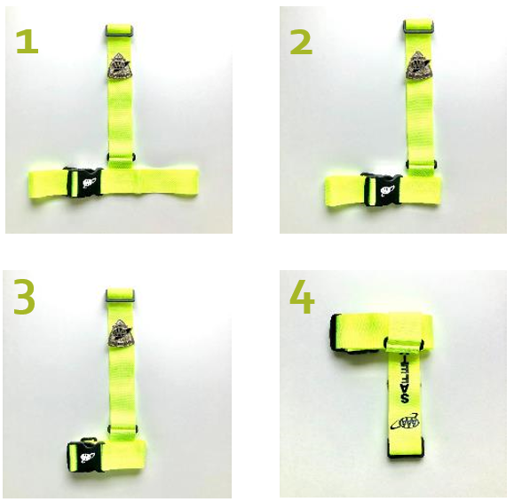
Folding the Patrol Belt
Notes:
Have a belt and show the students how it’s done.
Beginning with your patrol belt laying on a flat surface, match the waist portion of the belt together and then the shoulder portion of the belt together. It will look like an upside down T.
2. Fold under the right side of the waist portion of the belt.
3. Fold under the left side of the of the waist portion of the belt.
4. Fold under the shoulder portion of the belt so it wraps around the belt waist until folded completely.
Secure with a rubber band or place it in a plastic sandwich bag.

Slide 7
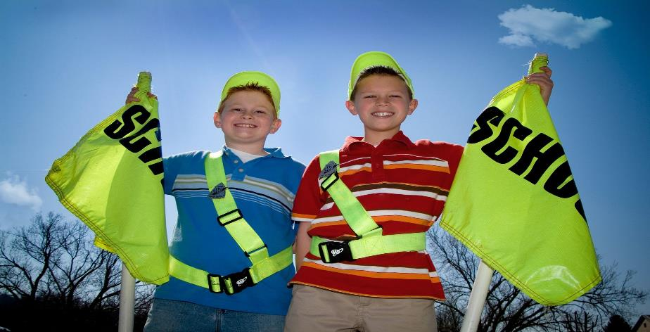
The Goal
To create a safe school environment by identifying safety hazards and being willing to help those in need.

Slide 8
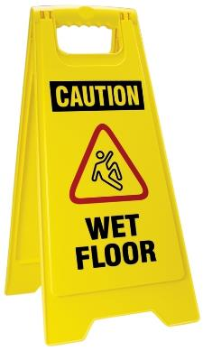
What is a
safety hazard?
A spill on the floor
A bee or wasp nest on the playground
Running in the halls
A stranger that doesn’t belong at the bus stop or near school
A fight amongst students
An animal that looks sick or isn’t normally around
Rough housing at the bus stop

Slide 9
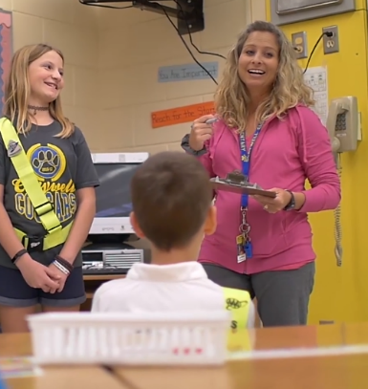
What to do in an
unsafe situation:
Use your best judgment.
Find the nearest adult and ask for help.
If there’s not an adult nearby, stay with the student(s) in trouble and ask a peer to get an adult.
For example: a student falls, hurts their ankle, and cannot walk

Slide 10
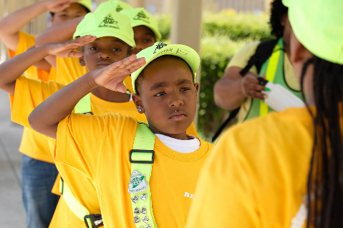
Qualities of a
Great Patroller
Models safe behavior at all times
Friendly and approachable
Willing to help others
Dependable

Slide 11
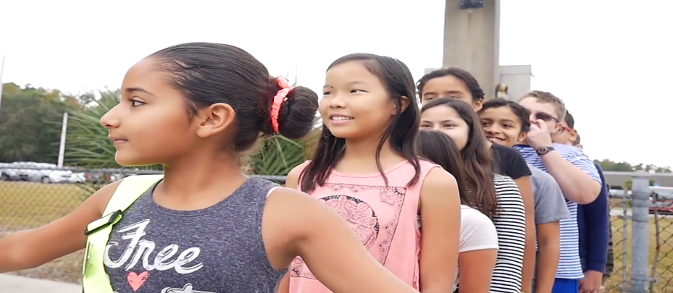
A Great Patroller
is NOT:
Bossy
Mean to fellow patrollers
Disrespectful to teachers or adults
One who believes they are better or have more power because they are a Patroller

Slide 12
How to
Earn Respect
Body Language: Stay alert at your post, wear your belt and badge proudly, and use body language that is welcoming.
Tone of Voice: Saying the exact same words but with different tones may be perceived very differently. Use a firm but kind tone.
Words: PLEASE and THANK YOU. Instead of saying “Don’t run!” try the opposite, “Please walk.”
Notes:
DO stand with arms at side and a smile.
DON’T stand with arms crossed looking mad, sad, uninterested.
Always be approachable.

Slide 13
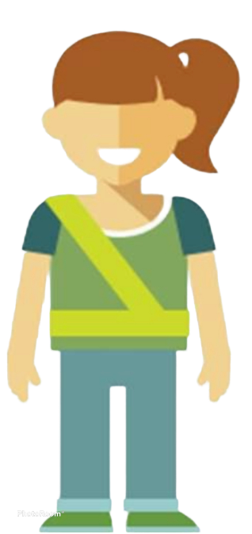
Trainee Exercise
Who wants to volunteer?
Let’s pretend that I (adult) am the 5th/6th grade Patroller and you are the kindergarten student.
My job is to keep students safe in the hallway.
Pretend to run past me.
Notes:
Trainee volunteer. “Remember when you were in Kindergarten or 1st grade how LARGE the 5th graders were? That’s you now! You are giants to them.”
Lets pretend that I (adult) is the 5th grade patroller and you (trainee) is the kindergartner. My job is to keep students safe in the hallway and you are running by.
#1 - [Pretend] intimidating posture, “STOP OR I’LL TELL ON YOU!!! I’M A SAFETY PATROLLER!”
Will “kindergartner” stop running? Maybe, because they will be scared of you.
#2 - Better option, “Hi that is an awesome backpack, sneakers, sticker (etc.). I’m Mary. What is your name? (shake hand). [Small talk] Hey, can you please do me a favor and not run in the hallways? I don’t want to see you get hurt. Thank you. Have a good rest of the day. [high five – but not during COVID].”

Slide 14
Trainee Exercise
Recap
What are the differences between example 1 and example 2?
What if you try this and it doesn’t work?
Notes:
Ask trainees differences between #1 and #2
Asked name, said please and thank you, told them my name, shook hands, asked them something about them, respect, etc.
Sounds like? Making a new friend. How cool would you have been in kindergarten if you had a friend in the 5th grade?
Will the kindergartner listen now? Still maybe, but you may have someone who will look up to you and want to keep you happy. If it works they may still need reminders from time to time. They may even get their classmates to behave because their friend in the SSP is looking out for them.
The main takeaway - #1 is a boss, #2 is a leader. Talk about the differences between those. Being boss is easy. Leadership takes practice. SSP is for leaders.

Slide 15
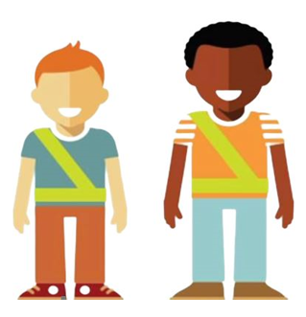
Trainee Exercise
Recap
Who is the best source for new ideas besides an Advisor or teacher?
FELLOW PATROLLERS!
Notes:
There may be a fellow Patroller who had the same issue on the other side of the school and found a different more effective way to solve the problem.

Slide 16
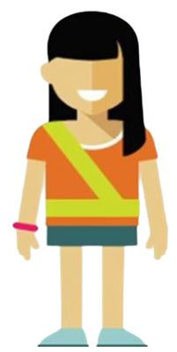
How to communicate
safe behaviors:
1. Politely ask the student(s) to stop the unsafe behavior
2. Add BECAUSE
3. Say THANK YOU especially if they listen
4. If the student(s) don’t listen:
Ask again firmly
Never lose your cool
If they still don’t stop, notify your advisor
Notes:
1. Always be polite and courteous. Treat others the way you would like to be treated
2. Adding “because” is more impactful to explain why the activity is unsafe instead of merely saying, “Stop!”
3. You can never say thank you enough
4. Many schools institute a 3 warning policy where if the patroller cannot get the student to stop after 3 attempts (can be over time), then they report to their advisor/specific adult

Slide 17
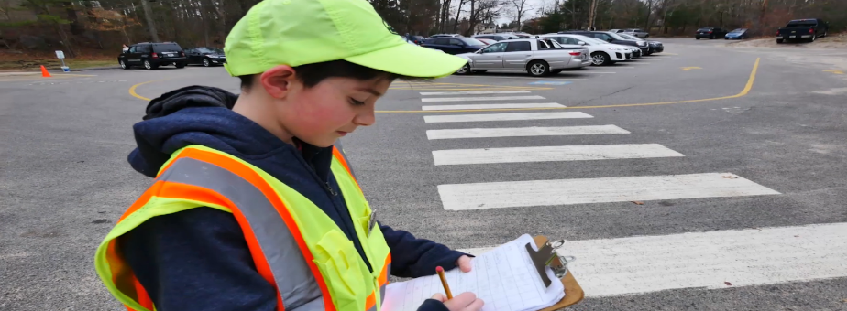
Officers of the Patrol
Additional jobs are assigned to those patrollers chosen as Captain, Lieutenant, and Sergeant.
Officers may:
Ensure all patrollers are at their posts
Report absences and arrange for substitutes
Create meeting agendas
Check daily attendance
Ensure all equipment is clean and in working order
Notes:
Officers should be chosen after Patrollers have had a few weeks on the job so Advisors can see who are natural leaders and role models.

Slide 18
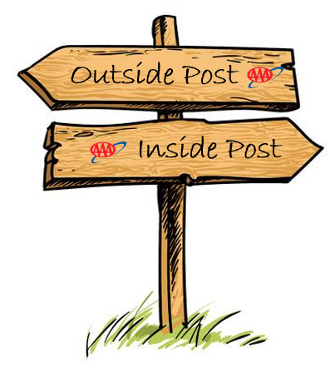
Types of Posts

Slide 19
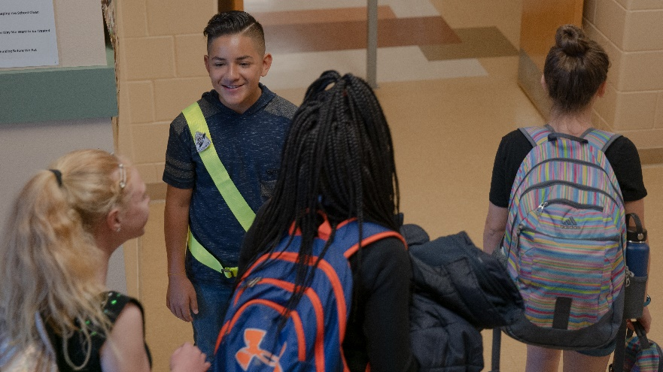
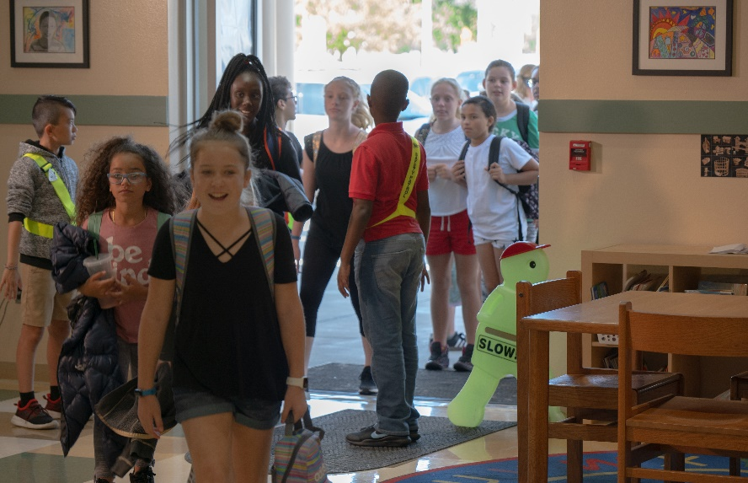
Hallway & Door Posts
Ensure students enter and exit doors without pushing or running.
Remind students to walk, use the right side of the hallway, and use caution at any stairwell.
Assist younger students who may need help getting to class.
Notes:
An adult should always be paired with a door post that opens to the outside. Patrollers should never be put in a position where they must allow/not allow visitors into the building.

Slide 20
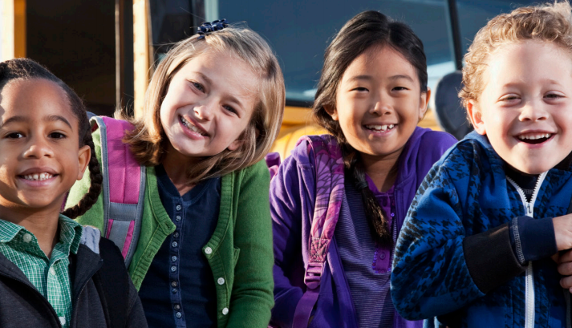
Kindergarten Escort
Posts
Keep them in view at all times
Make sure they stay away from traffic
Stay with them until they reach their destination

Slide 21
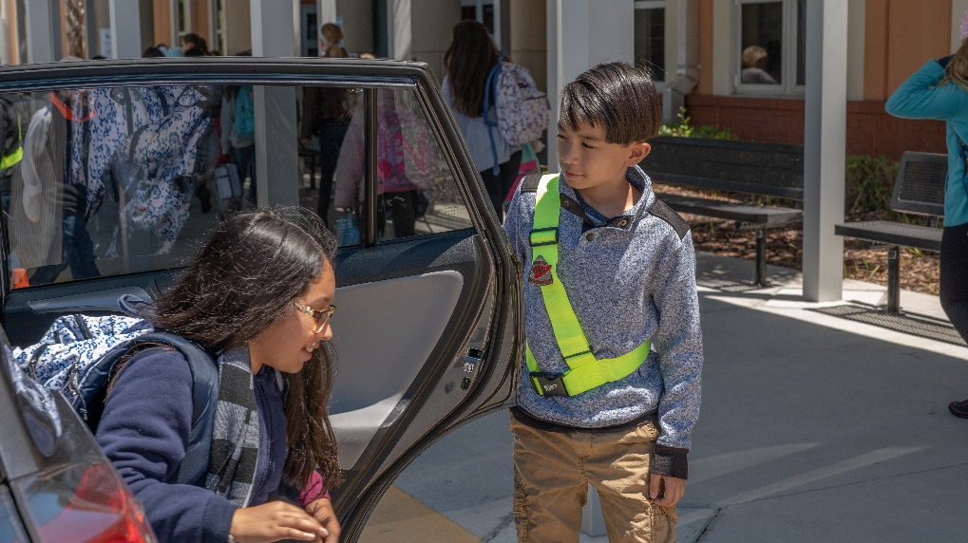
Car Rider Posts
Help students enter/exit their vehicle safely.
Encourage students to exit and move away from car line as they walk toward the building.
Make sure no students reach under any vehicle to retrieve an item that may have fallen or blown away.
NEVER direct traffic.
Notes:
Patrollers NEVER direct cars/traffic, only students.

Slide 22
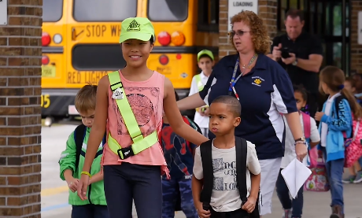
School Bus Posts
Follow all bus rules
Stay seated
Be alert to any safety hazards
Notify the driver if there is an emergency
Notes:
Bus Patrollers are the extra eyes and ears on the school bus. If there is an emergency they should safely communicate it to the bus driver without placing themselves in danger (ex. Walking through the aisle while the bus is moving).

Slide 23
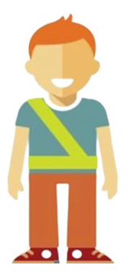
Reminders to Keep
YOU Safe
Never direct traffic.
Don’t approach or allow others to approach unknown drivers.
Don’t help strangers with directions.
Never give out personal information like your name, address, or phone number to unknown adults.

Slide 24
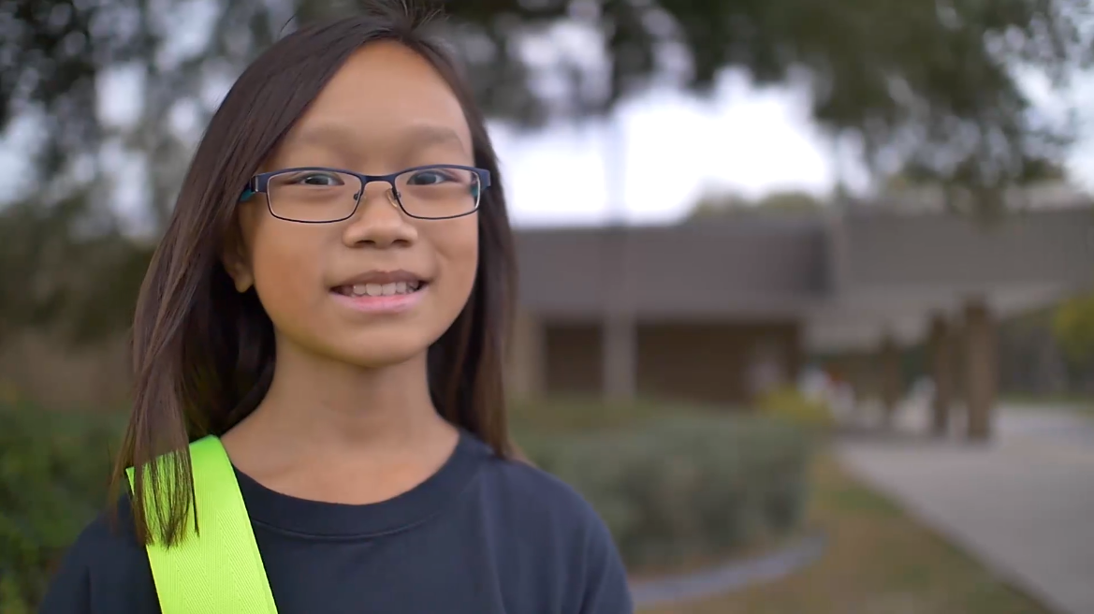
Final Reminders
Always be respectful and alert.
Pay attention 100% when at your post.
Never allow yourself to get angry with others.
Look to adults to handle issues beyond your control.
Be proud of your role.

Slide 25
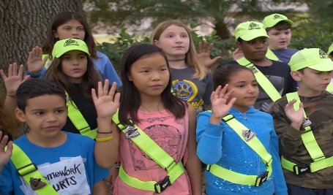
The Pledge
I promise to do my best to:
Report for duty on time,
Perform my duties faithfully,
Strive to prevent injuries, always setting a good example myself,
Obey my teachers and officers of the patrol,
Report dangerous student practices,
Strive to earn the respect of fellow students.
Notes:
Advisor/AAA Representative:
Please stand and raise your right hand.
Repeat after me, “I promise to do my best to…”
Congratulations, you are now officially a member of the AAA School Safety Patrol!

Slide 26
CONGRATULATIONS & GOOD LUCK!

