Slide 1
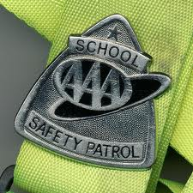
School Safety Patrol
Training Program
Notes:
Welcome
Introduce self
Today we are going to hear about the history of the Safety Patrol Program, what it takes to be successful in the job and some reward programs.

Slide 2
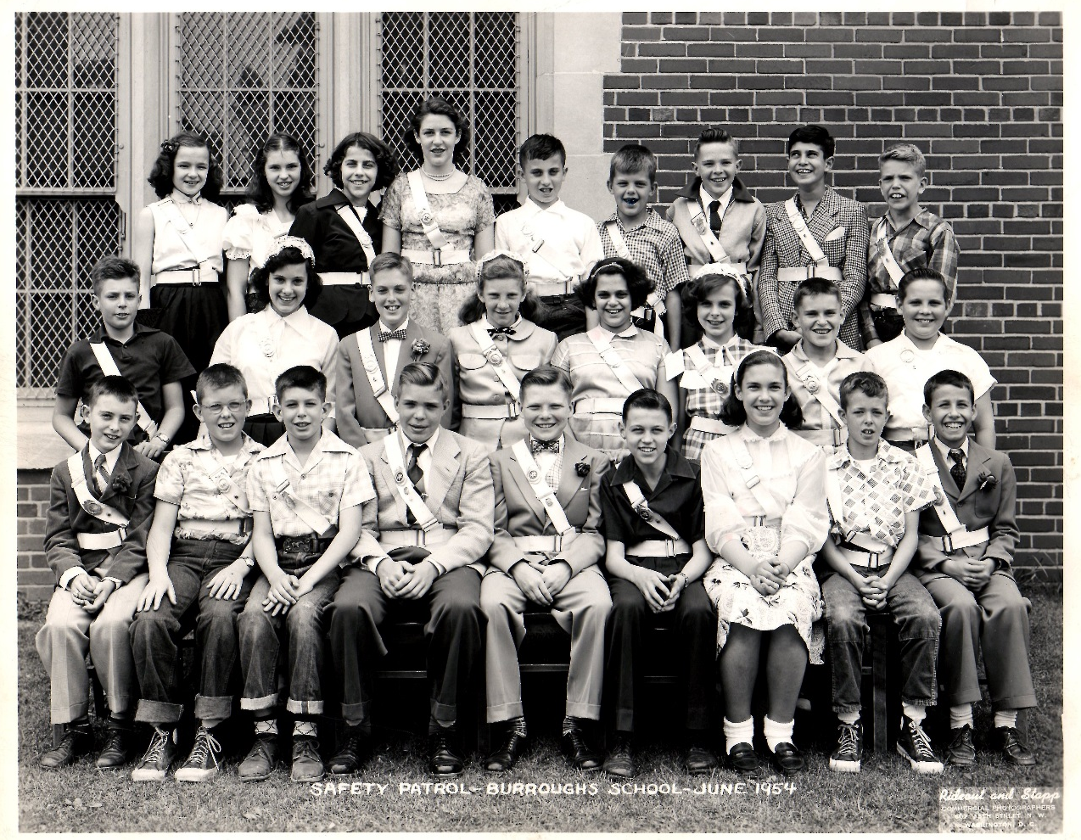
HISTORY
Notes:
Welcome
Introduce self
Today we are going to hear about the history of the Safety Patrol Program, what it takes to be successful in the job and some reward programs.

Slide 3
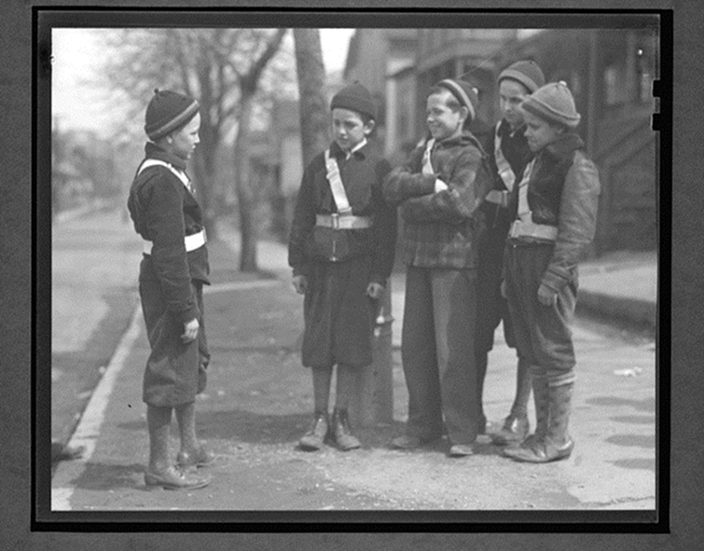

The Safety Patrol Program Began
A Long Time Ago!
1920
Tomorrow’s Leaders Today
Notes:
PRESENTER NOTE: The year 1920 will appear after you click the second time
The Safety Patrol program has been around a very long time. Looking at this photo you can tell that I didn’t take it with my cell phone yesterday. Tell me how you know this photo was taken a long time ago…..
B&W
Clothes
Boots
Can someone give me a guess as to when the first safety patrol program started?

Slide 4
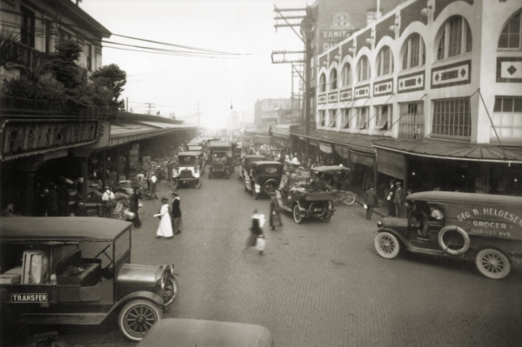
Chicago, Illinois
Tomorrow’s Leaders Today
Notes:
This is where the School Safety Patrol was founded – in the city of Chicago, Illinois.
When you look at this picture you’ll notice there was something relatively new in those days. What do you think that was?
Cars – people weren’t exactly sure how reliable they were, they didn’t have the control or consistent speed that cars have today and they didn’t stop as well as cars do today.
One day several children at a school crossing were killed by a speeding car.
Charles M. Hayes , president of the Chicago Motor Club, horrified by the incident, pledged to help prevent such a tragedy from happening again.
He gathered some of his employees and decided that they would establish a program where the oldest sutdents in the school would be safety leaders, helping all students get to and from school safely.
The first patrol was established with two dozen boys trained to assist students cross the road safely

Slide 5
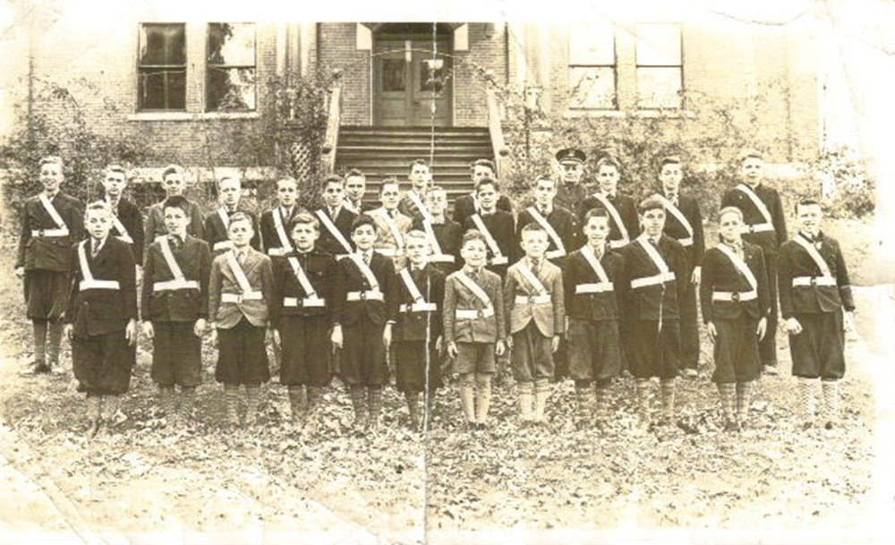
In the beginning
Girls were not allowed to participate
Tomorrow’s Leaders Today
Notes:
Ladies – when the program began, we couldn’t participate.
Why do you think they didn’t allow girls to participate back in the 1920’s?
Girls were not considered as strong as boys
Girls were not given dangerous jobs
Men were considered to do most of the outside work and women he inside work

Slide 6
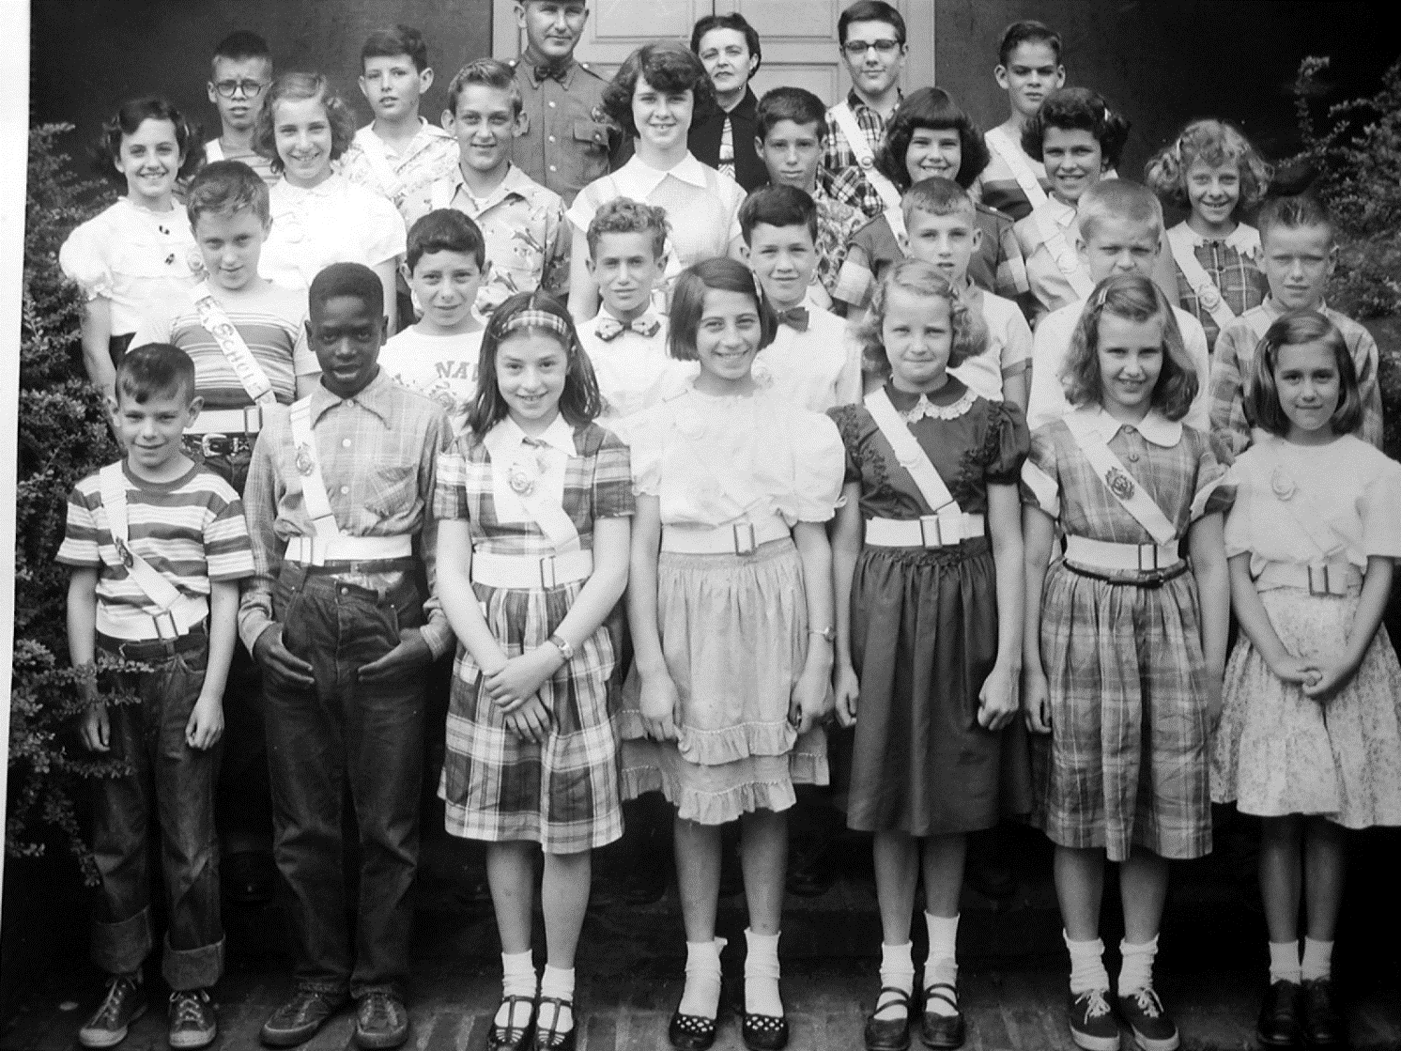
By the 1950’s all could apply
Tomorrow’s Leaders Today
Notes:
But schools eventually wanted girls and boys to participate and so they allowed girls to patrol inside the schools. And by the 1950’s all could apply.

Slide 7
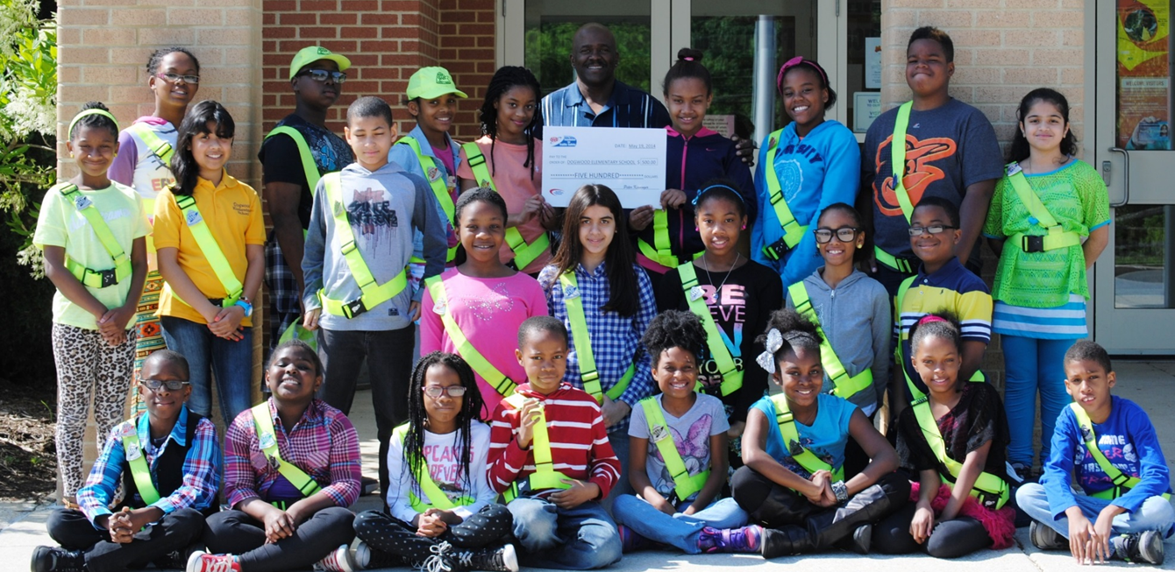
Over 635,000 students nationwide
Tomorrow’s Leaders Today
Notes:
Today, anyone can apply for the Safety Patrol job as long as they have met all the requirements of the school, they have adult permission from home and they follow all the rules of the job.
Across the United States over 635,000 girls and boys participate in the program.
If you would go to a school in California or New York, the Safety Patrols will be wearing the exact same belt and badge that you will be wearing here at your school. Like the Safety Patrol, AAA is also in every state, helping schools with the program.

Slide 8
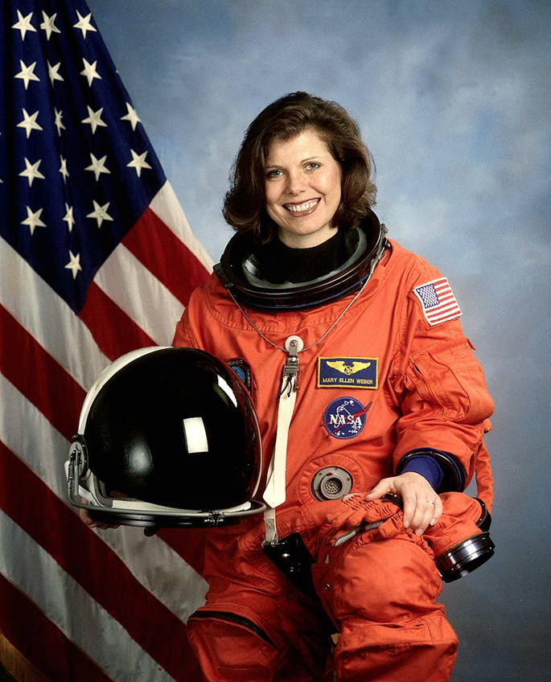
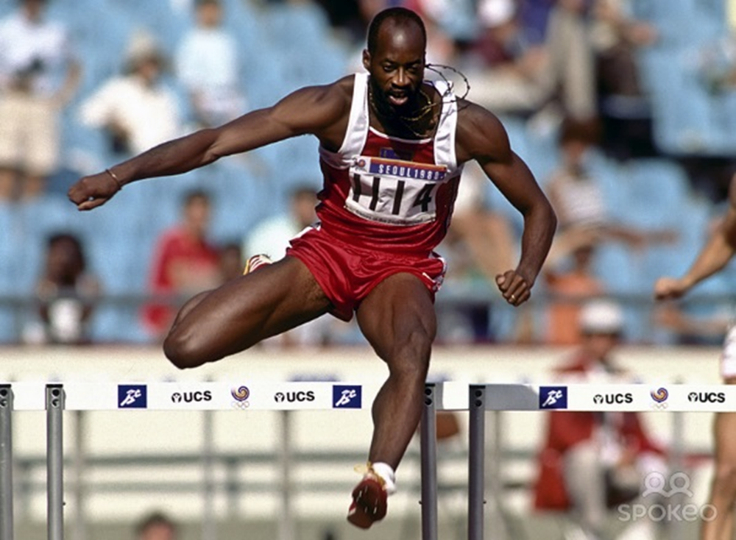
Famous Safety Patrollers
Edwin Moses
Olympic Gold Medalist
Mary Ellen Webber
NASA Astronaut
Tomorrow’s Leaders Today
Notes:
Now there have been some very famous people who were Patrols when they were in school. Astronauts and Olympians!

Slide 9
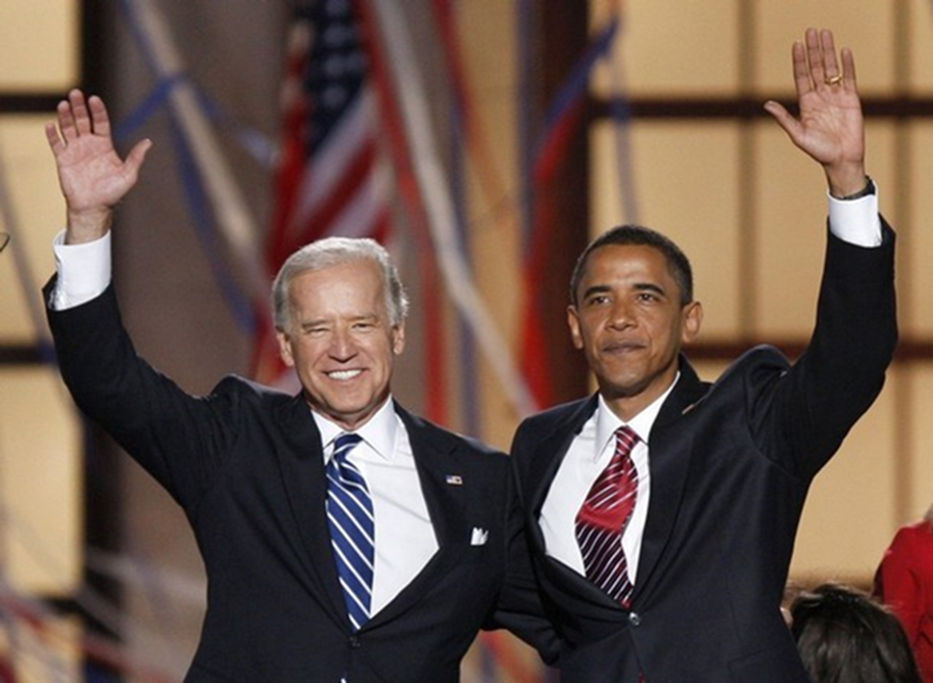

Famous Safety Patrollers
Tomorrow’s Leaders Today
Notes:
PRESENTER NOTE: The yellow arrow will appear on the second click
Now I know you all know the gentleman on the right but who is this gentleman (click for arrow to appear)?
If students don’t know who he is ask the question:
What is the job of the gentleman on the right? President
So what do you think the job of the gentleman on the left would be? Vice President
Continue to give clues if they don’t know his name
Joe Biden was also a patrol when he was a child.

Slide 10

More Famous Safety Patrollers
5 U.S. Supreme Court Justices
3 Baseball Hall of Famers
21 Astronauts
4 Governors
Tomorrow’s Leaders Today
Notes:
In fact, there are many people who started their first leadership role in the Safety Patrol and went on to do great things.
Chief Justice Warren E. Burger Anthony M. Kennedy Stephen G. Breyer Clarence Thomas William J. Brennan, Jr.
Joe Garagiola, Baseball Hall of Famer
Tom Seaver, Baseball Hall of Famer
Al Kaline, Baseball Hall of Famer
I want you to go home tonight and find out if anyone in your family was a Safety Patrol. I bet you’ll be surprised to find out there are!

Slide 11
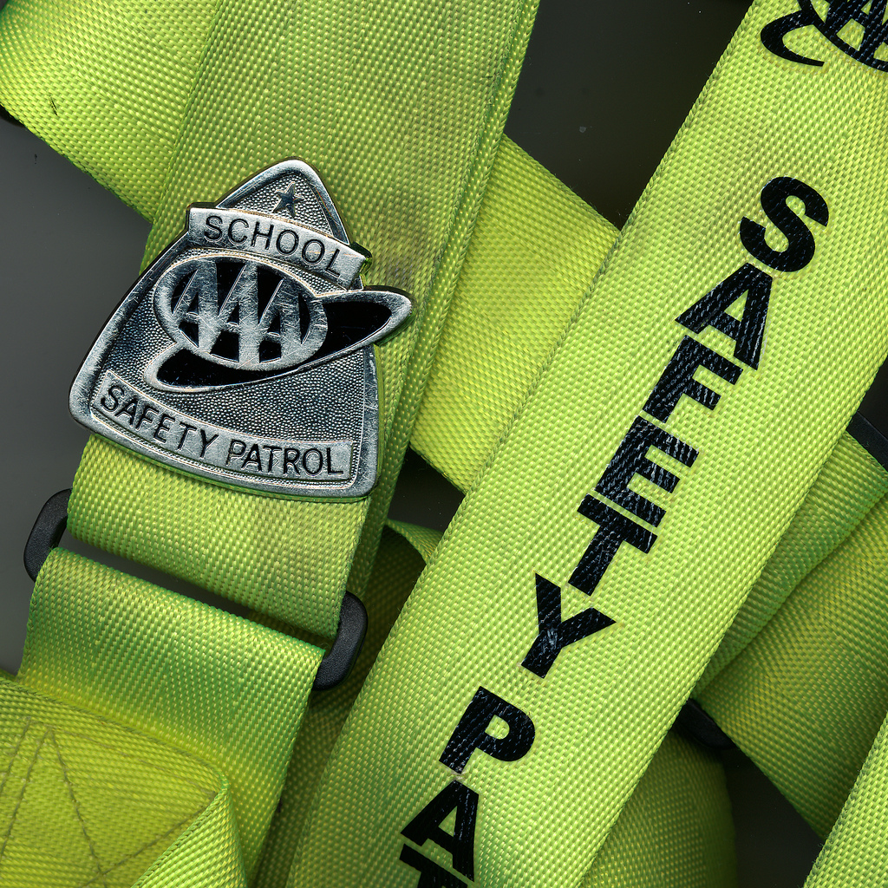
THE UNIFORM
Tomorrow’s Leaders Today
Notes:
Welcome
Introduce self
Today we are going to hear about the history of the Safety Patrol Program, what it takes to be successful in the job and some reward programs.

Slide 12
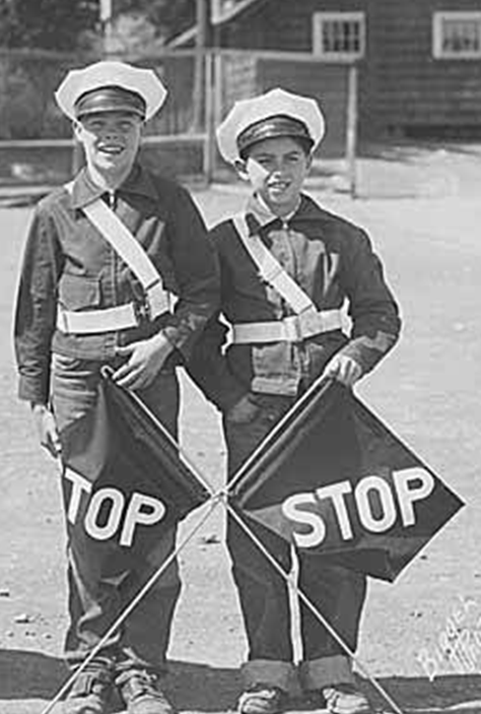
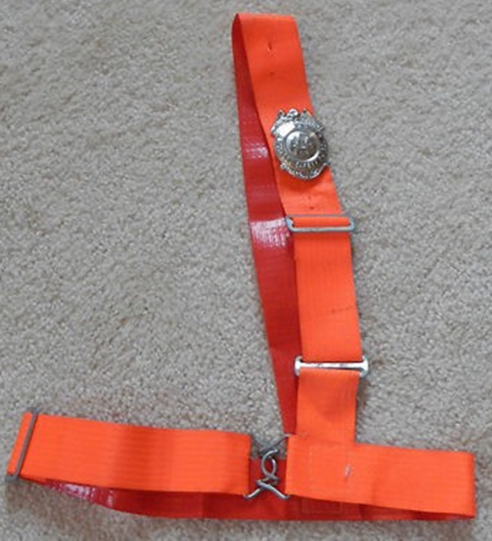
Patrol Belt and Badge
Tomorrow’s Leaders Today
Notes:
Just as the program has grown and changed, so has the belt.
It started as a white, very thin plastic belt that clasped in the front with a metal buckle.
Then we went with an orange color
Why do you think we went with orange?
Brighter
Easier to see

Slide 13
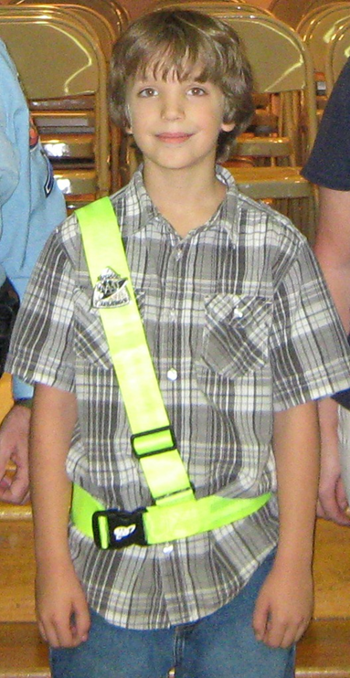
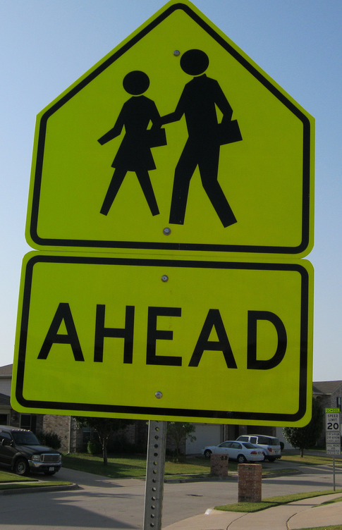
Fluorescent Yellow-Green
Tomorrow’s Leaders Today
Notes:
PRESENTER NOTE: Second photo will appear with a second click
Now our belts are fluorescent yellow-green or as we like to call them ‘Lectric Lim!
What have you seen outside that is the same color as your patrol belt?
Street Signs
AAA changed the color of the belts when the federal government changed the color of their road signs that relate to pedestrians, bicycles and school warning signs.

Slide 14
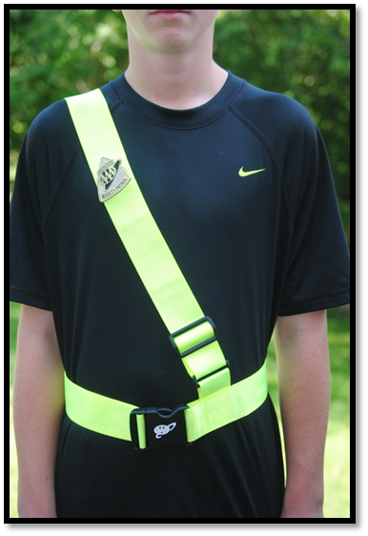
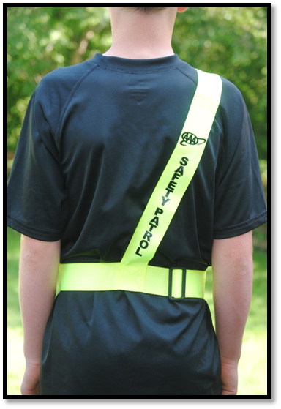
The Uniform
Everyone wears it the same way
Tomorrow’s Leaders Today
Notes:
Just like a team, everyone needs to wear the uniform the same way. Let’s practice putting on our patrol belts and making sure everyone knows how to adjust.
Explain the two adjusters

Slide 15
Folding the Patrol Belt
Tomorrow’s Leaders Today
Notes:
PRESENTER NOTE: Each photo will appear as you click.
Have a belt and show the students how it’s done.
Beginning with your patrol belt laying on a flat surface, match the waist portion of the belt together and then the shoulder portion of the belt together. It will look like an upside down T.
2. Fold under the right side of the waist portion of the belt.
3. Fold under the left side of the of the waist portion of the belt.
4. Fold under the shoulder portion of the belt so it wraps around the belt waist until folded completely.
Secure with a rubber band or place it in a plastic sandwich bag.

Slide 16
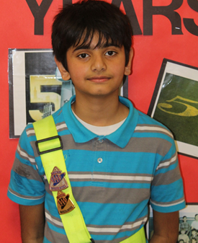
The Gold Badge
Reward for a special act
Worn with your regular badge
Tomorrow’s Leaders Today
Notes:
The gold badge is awarded when your patrol advisor sees a patrol doing something extraordinary. It may be a special act of kindness or helping out another member of the patrol in a special way.
If awarded the gold badge you will wear it beneath your regular badge.
Once a new patrol earns the gold badge you will give that person the gold badge.

Slide 17
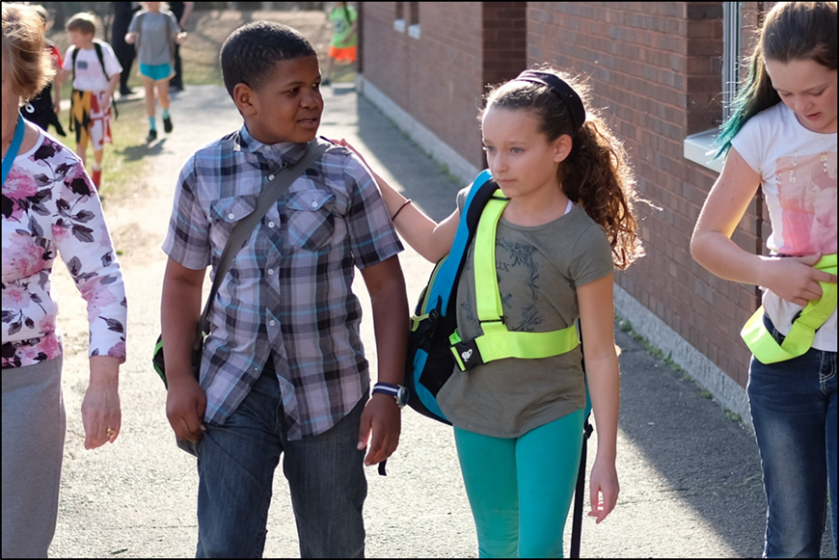
GOALS and BEHAVIOR
Tomorrow’s Leaders Today
Notes:
Welcome
Introduce self
Today we are going to hear about the history of the Safety Patrol Program, what it takes to be successful in the job and some reward programs.

Slide 18
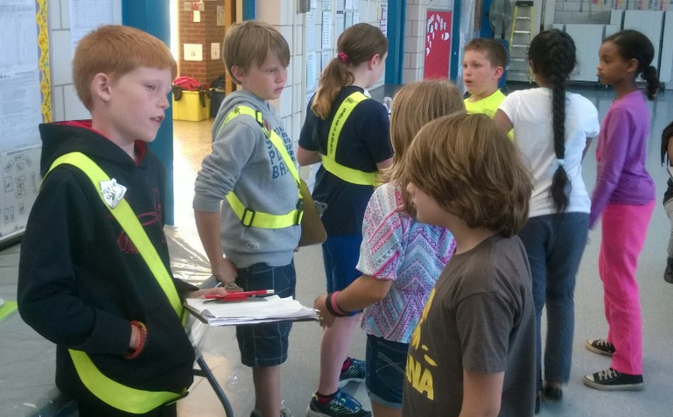
Goals of the Safety Patrol
Help keep students safe during arrival and dismissal
Help bus drivers keep students safe on the bus
Help maintain order in the hallways.
Tomorrow’s Leaders Today
Notes:
PRESENTER NOTES: These goals can be customized to fit the school’s needs. If no patrols are on busses, remove the second bullet
These are the goals of the Safety Patrol. When you look at these three lines you will see one word that is underlined. What is the word?
Help
That’s right. Help is the key word which means that you are there to help the adults keep kids safe. The adults will always be making the rules and be in charge while the Patrols will be helping adults keep kids safe.

Slide 19

Qualities of a GREAT
Safety Patroller
Role Models Safe Behavior
Friendly and Compassionate
Good Attendance and Dependable
Excellent School Effort
Tomorrow’s Leaders Today
Notes:
These are the qualities of a great Safety Patroller. I’m looking for someone to read me the first line and give me an example of how you, in your Safety Patrol job, can give me an example or explain why this is important on the job.
Role Models Safe Behavior – If Patrols don’t act safely then others will think they don’t have to behave safely.
Friendly and Compassionate – Most of your safety reminders and help will be directed at the younger students. Think back to when you were a kindergartener and how sometimes it was scary to come into school with so many older kids. When you’re friendly and compassionate to these students you may just make their day. In fact, you may help that student feel better about coming to school which will help them learn easier.
Good Attendance and Dependable – If you show up for school on time we know we can count on you to show up at your post on time.
Excellent School Effort – We have never heard a school say they will only use A students on the patrol. But most schools will say they wants patrols who show good school effort. This is because students that show good school effort demonstrate that they are trying hard and want to do a good job. The same holds true in the patrol job.

Slide 20
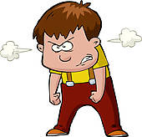
Safety Patrollers Are Not:
Bossy or Rude
Mean to other members of the Patrol
Disrespectful to teachers or adults
On a power trip
Tomorrow’s Leaders Today
Notes:
PRESENTER NOTES: When you click the second time the bullets will appear all at once
What are some behaviors that we don’t want to see in Safety Patrollers?
Give students time to come up with a list and then click and the bullets will appear.

Slide 21
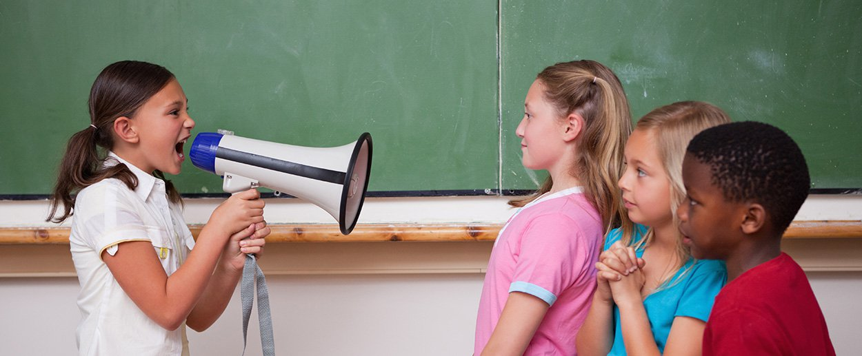
Earning Respect
Getting Others to Listen
Body Language … Tone of Voice … Words
Tomorrow’s Leaders Today
Notes:
One of the hardest parts of being a patroller is getting other people to listen to you. The best way to do this is by earning respect of fellow students. There are three things that will help you with earning respect.
Body language – stay alert at your patrol, wear your belt and badge correct and use body language that says you want to help others
Tone of Voice – you can say the exact same words but with different tones they may be perceived very differently by others. Remember a firm but kind tone.
Words – the two most important words you learned as a toddler – please and thank-you are still very important today. Try to stay away from the negatives like “don’t walk” but rather think of a more positive way to ask others to be safe, like “please walk.”

Slide 22
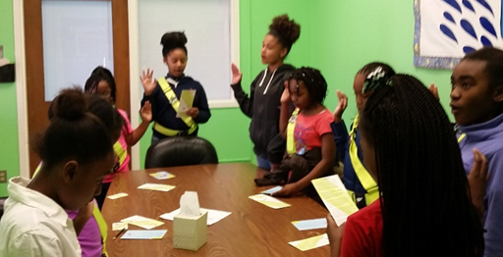
Officers of the Patrol
Captain, Lieutenant and Sergeant
Make sure all Patrollers are at their post
Agendas for meetings
Help assign posts and arrange for substitutes
Fill-in for absent Patrollers
Attendance
Report repeated latenesses
Patrol bulletin board
Keep record of all equipment
Tomorrow’s Leaders Today
Notes:
Your school will be looking for some “Leaders of the Leaders” which means officers will be chosen.
Officers are Captains, Lieutenants and Sergeants.
The officers will have some extra duties and will be in charge of helping your adult advisor oversee the smooth running of the patrol.

Slide 23
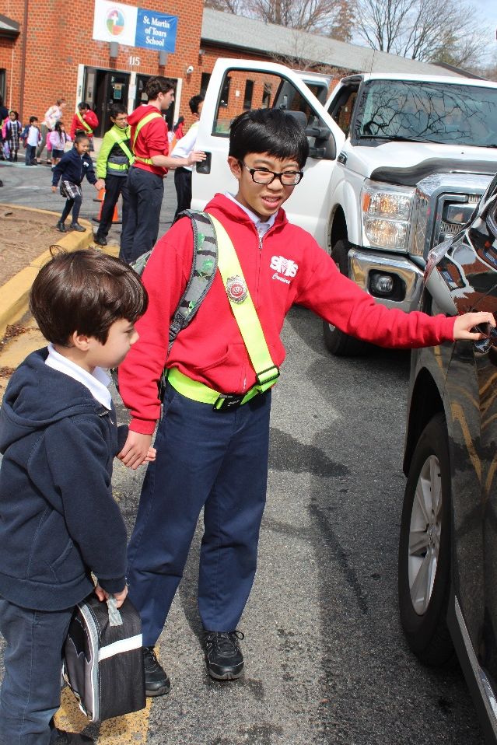
POSTS
Tomorrow’s Leaders Today
Notes:
Welcome
Introduce self
Today we are going to hear about the history of the Safety Patrol Program, what it takes to be successful in the job and some reward programs.

Slide 24
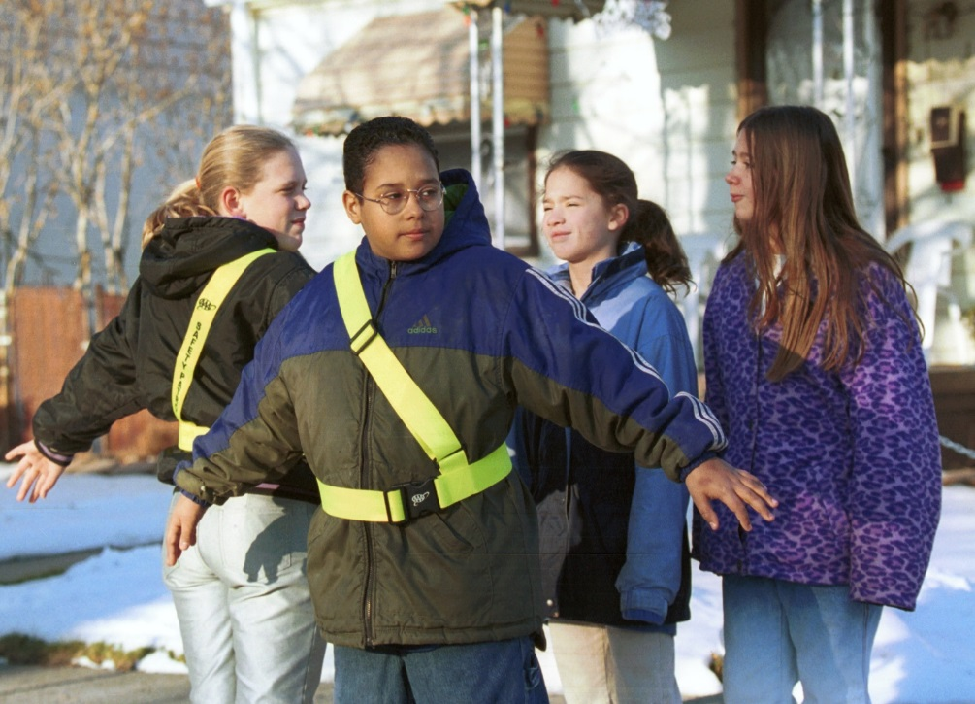
Crosswalk Post
NEVER DIRECT TRAFFIC
Take position one foot back from curb
Check all directions for traffic
Determine how to judge a safe gap
Keep students a safe distance back
Tomorrow’s Leaders Today
Notes:
PRESENTER NOTE: The yellow highlighted box will appear on the second click
This is also when the patrol positions – Hold – Go – At Ease – can be demonstrated.
Hold is a student with palms back and arms outstretch. Go is stepping to the side and letting kids pass through.
The role of the crosswalk post is to make sure children don’t enter the street until it is safe to do so. Many times an adult crossing guard will be working in the street, directing traffic. The patrol’s job is to only direct children, never traffic. Wait for the crossing guard’s cues and follow these guidelines:
Before arriving at their post, place their backpacks and other belongings in the designated safe place at the school so they do not interfere with their duties
Arrive at their post early
Determine how to judge a safe gap for each posted position
Take a position at least one foot back from the curb or edge of the street, arms down at a 45-degree angle, palms facing back
Check all directions for traffic
Keep students a safe distance from traffic
Keep arms and palms positioned to hold all students from traffic until there is a safe gap
Never allow students to walk in front of a car that stops unless the Patrollers gives an appropriate signal or sign to allow them to cross
Step aside and motion students across the street
Continue to monitor traffic until the safe gap ends, then hold students back on the curb
Step into the street only far enough to see around an obstruction

Slide 25
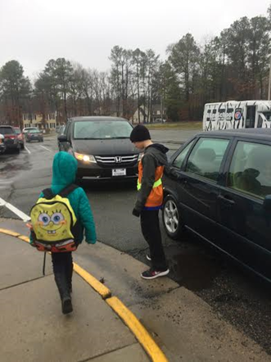
Car Rider Post
NEVER DIRECT TRAFFIC
Help students enter/exit vehicle safely
Keeps students behind line
Assist small children whose arms are full
Make sure no students reach under a vehicle to pick up any fallen item
Tomorrow’s Leaders Today
Notes:
PRESENTER NOTES: The yellow highlighted box will appear on the second click
Patrollers at drop-off zones in front of the school protect carpoolers.
The school car rider area works as follows:
Patrollers are placed along the curb where the drop-off lane has been established and are evenly spaced a car’s length apart.
An adult waves the lead vehicle through the lane to the exit point, then indicates for the vehicle to stop
Once all vehicles have come to a full stop, the nearest Patroller opens the curbside vehicle door, greets the driver and student and allows the student to exit the vehicle.
The Patroller thanks the driver, closes the door and gives a hand signal or verbal command to indicate he or she is clear of the vehicle.
Patrol responsibilities at the Car Rider area are as follows:
Helps students enter and exit vehicles safely
Assisting small children and students whose arms are full
Reminding students to stay on the sidewalk and cross only in designated areas
Prohibiting students from reaching under a vehicle to pick up an item for any reason

Slide 26
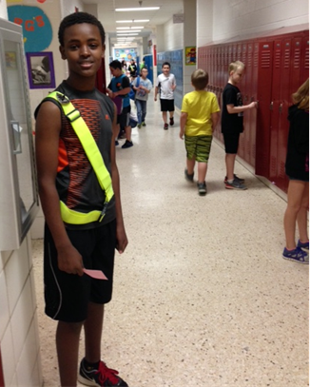
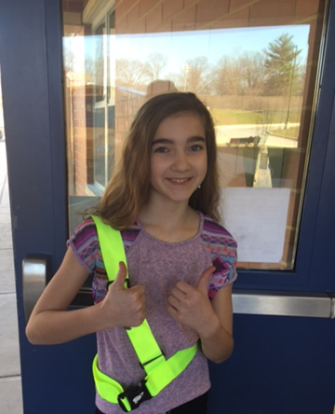
Hall and Door Posts
Ensure students enter building without pushing, running or shoving
Help younger students get to class
Remind students to walk, use the right side of hallways and use caution on stairwells
Tomorrow’s Leaders Today
Notes:
The hall and door patrols will be extra ears and eyes for the adults at your school. They will be responsible for the following:
Making sure students enter the building without running, pushing or shoving
Helping smaller students get to their classrooms
Remind students to walk, use the right side of the hallways and use caution in stairwells

Slide 27
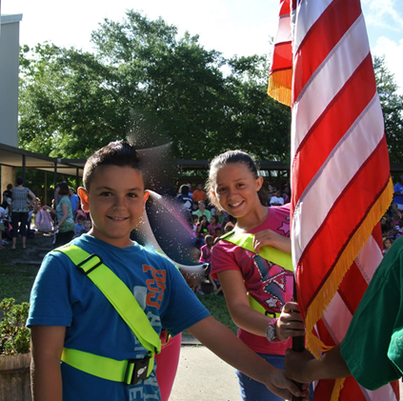
Flag Post
Treat with respect
Never touches ground
Properly fold the flag
Tomorrow’s Leaders Today
Notes:
Raising and lowering our United States flag is both a privilege and a responsibility. Many times a trained boy or girls scout will be chosen for this post.
Patrols that have this duty should treat the flag with the respect it deserves.
As the flag is lowered, NO PART OF IT SHOULD TOUCH THE GROUND or any other object; other patrols should be waiting to receive the flag as it is lowered.
The flag should be properly folded.

Slide 28
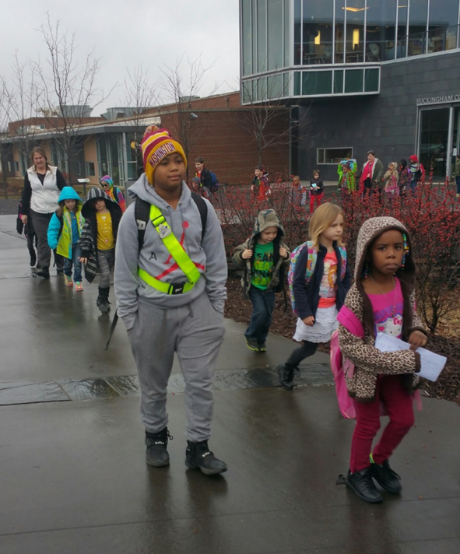
Kindergarten Escort Posts
Keep children in view at all times
Make sure they are away from all traffic
Stay with all children until they reach their destination
Safety reminders (walking, hands to self)
Tomorrow’s Leaders Today
Notes:
Your school has pre-K and kindergarten students that need some extra help when walking to their bus, car or adult. As a patrol escort it is your responsibility to be a safe role model and to ensure these young children stay safe, away from traffic.
Follow these guidelines
Keep children in your care, within your site at all times
Keep children away from traffic and in designated areas while walking
Always stay with the children until they reach their intended destination (adult, bus or car)
Help teach students safety rules like walking and hands to self

Slide 29
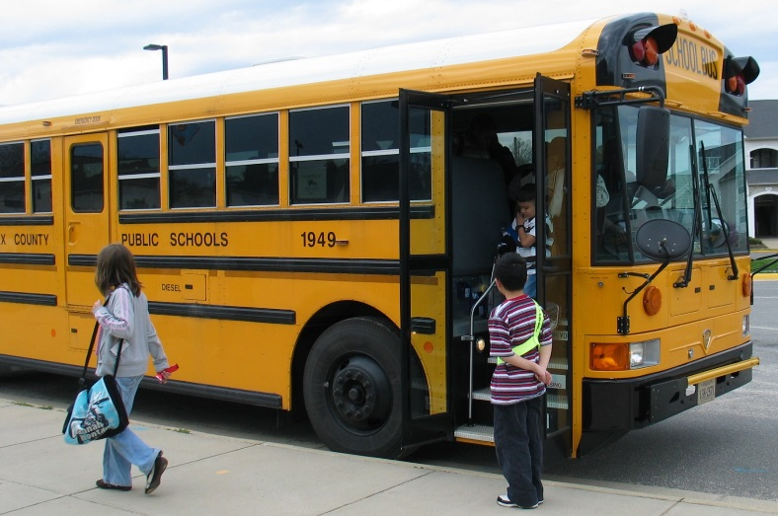
School Bus Post
Patrols on the Bus
Exits the bus at each stop and takes a position beside the step
Helps students enter the bus at stops and during dismissal
Helps the bus driver keep order on the bus
Makes sure students do not forget personal items
Assists in an emergency
Tomorrow’s Leaders Today
Notes:
Bus Patrollers are usually students from the first bus stops in the morning and the last bus stops in the afternoon. They provide assistance for the entire route.
Busses that have a front and back patroller will be assigned a seat by the bus driver. It is important to remember that the bus driver is always the boss of the bus and enforces all rules.
In addition to being a role model and following all bus rules, the Patrol will help keep order, make sure no one forgets any personal items on the bus and will assist in an emergency.
School bus drivers will give additional training once you are assigned to your post.

Slide 30
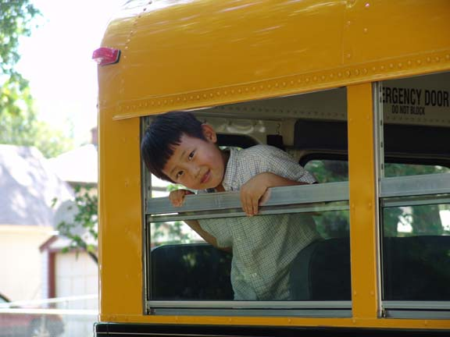
Role Models on the School Bus
  Sitting forward
  Hands inside
  Inside Voices
  Backpacks stowed
Tomorrow’s Leaders Today

Slide 31
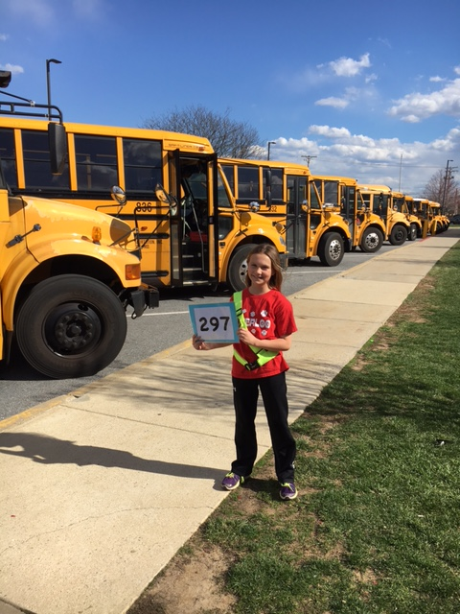
Bus Loop Post
Holding Bus Numbers
Hold the bus number to be sure younger children enter the correct bus
Stay alert to children who may wander from safe area of busses
Make sure no one reaches under a bus for fallen items
Tomorrow’s Leaders Today
Notes:
Bus number/color holders are positioned in front of one bus to ensure that younger children get on the correct bus.
In addition, these patrols must remain alert to children who may wander from the safe area around busses or may reach under the bus if something is dropped.

Slide 32
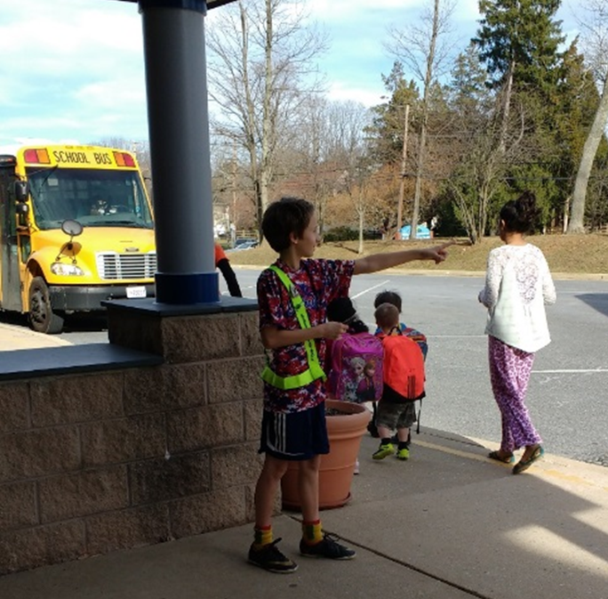
Walkways/Front of School Post
Remind students to walk
Ensure everyone enters building safely, no wandering!
Help younger, timid students feel better about coming to school
Tomorrow’s Leaders Today
Notes:
The front walkway is an important position since this patrol will be responsible for making sure students are walking, enter the building safely and help younger students who may be timid about coming to school, more comfortable.

Slide 33
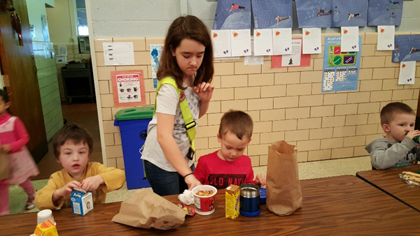
Breakfast Post
Help younger students opening containers
Remind them to clean up after themselves
Make sure no personal belongings are left behind
Tomorrow’s Leaders Today
Notes:
This post will help adults with younger children that arrive early to school for breakfast. Responsibilities will include helping them open containers, making sure they remember to clean up after themselves and reminding them if they forget any belongings, like mittens or hats during winter months.
It is important to teach these children responsibility so don’t clean up FOR them but rather gently remind them to clean up after themselves.

Slide 34
Outside Patroller Safety
NEVER direct traffic!
Don’t approach cars or allow other students to approach unknown drivers
Don’t help strangers with directions
Never give your name, address, phone number, or other family information
Tomorrow’s Leaders Today

Slide 35
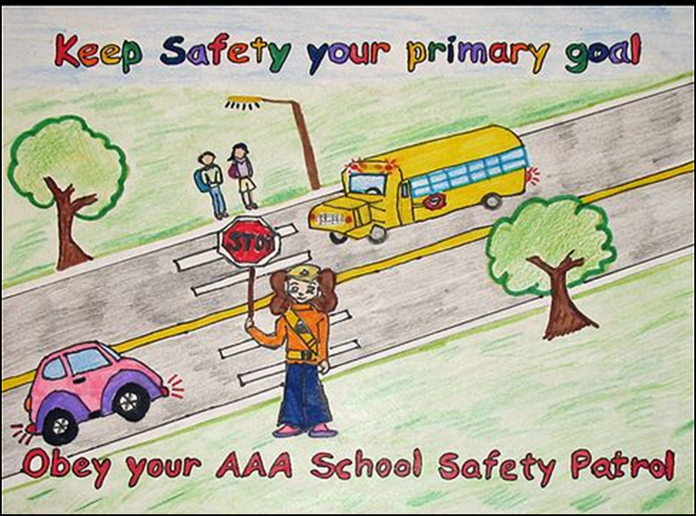
When To Find An Adult
Student Violence
Injuries
Tomorrow’s Leaders Today
Notes:
There are two instances when you will immediately need to find an adult.
Student violence
Injuries
Never try to get in the middle of a fight or try to break up two students that are fighting. Let adults handle these situations.

Slide 36
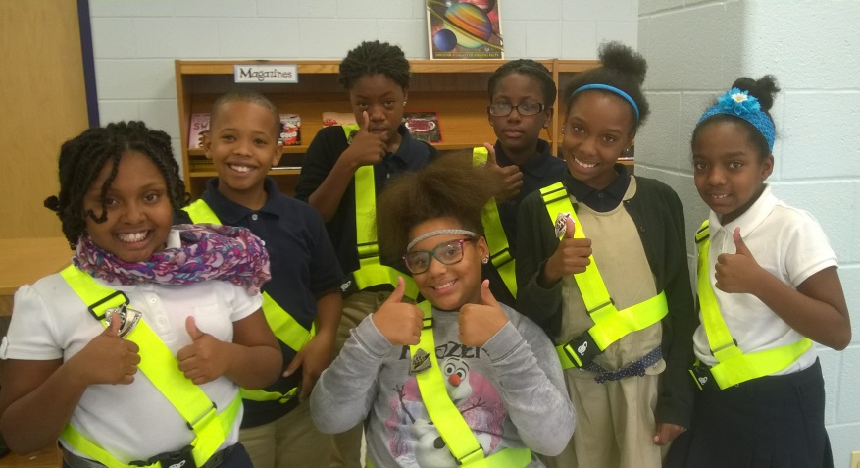
Final Reminders
No matter how hard you try, you can never completely control others
Always show respect
Try not to get angry
Be fair, be kind
Let adults handle issues
  beyond your control
Tomorrow’s Leaders Today
Notes:
Remember, you will never be able to control everyone’s actions all the time. There will be students that don’t want to listen and maybe peers that wish they were a patrol but weren’t chosen. Keep these points in mind:
Always show respect
Try not to get angry
Be fair and kind
Let adults handle issues beyond your control

Slide 37
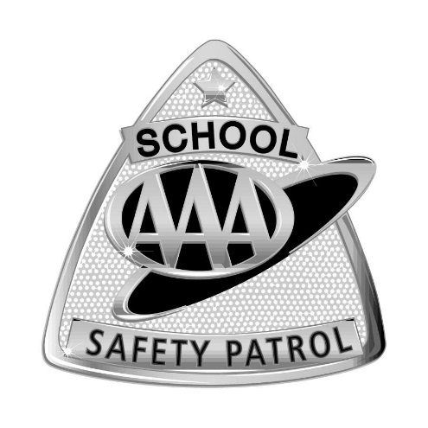
Patrol Pledge
I PROMISE TO
Report for duty on time,
Perform my duties faithfully,
Strive to prevent accidents, always setting
a good example myself,
Obey my teachers and officers of the patrol,
Report dangerous student practices,
Strive to earn the respect of fellow students.
Tomorrow’s Leaders Today
Notes:
If school wants patrollers sworn in during training have each student stand, raise their right hand and receipt the pledge aloud.
If swearing in will take place at a later time or during an assembly, have patrollers read the pledge aloud and tell them they are expected to memorize the pledge before the ceremony.

Slide 38
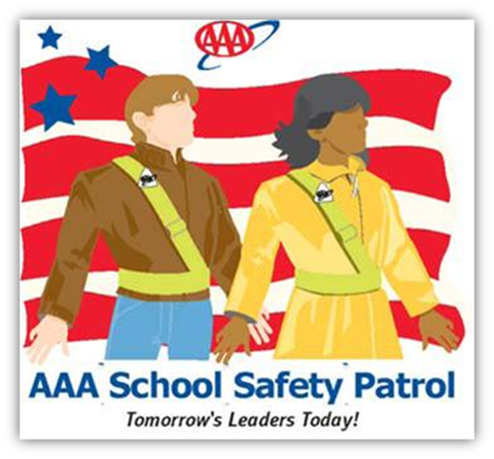
Good Luck
School Safety Patrollers!

